Slide 1
AMS Reporting Support of May, 2020
China

Slide 2
Incidents – AMS China
Comments
Total number of incidents 34% increased, compare to number of month of May 2019.

Slide 3
Incidents – AMS China
Comments
Total number of incidents increased by 7%, compare to number of month of Apr 2020.
Top 5 application are FFMS, MTS, Pass, ODS, China Procurement System

Slide 4
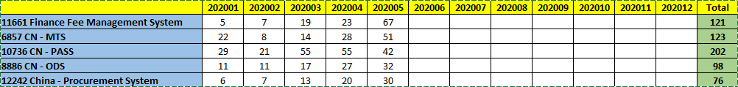
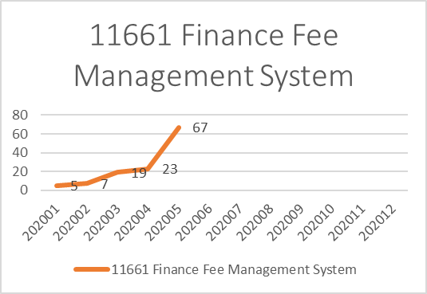
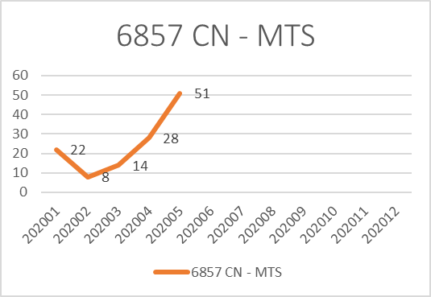
Incidents – AMS China
Incidents Trends Of Top 5 Application By Year

Slide 5
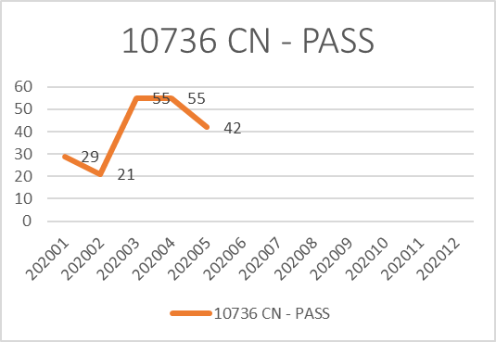
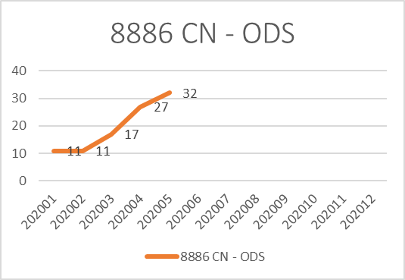
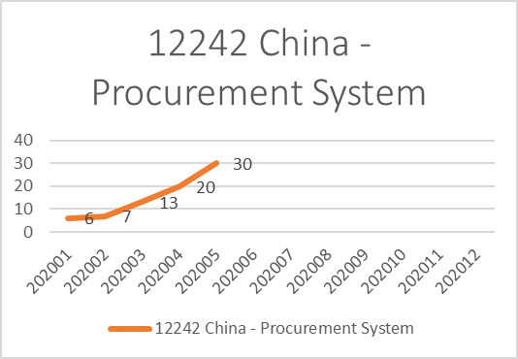
Incidents – AMS China
Incidents Trends Of Top 5 Application By Year

Slide 6
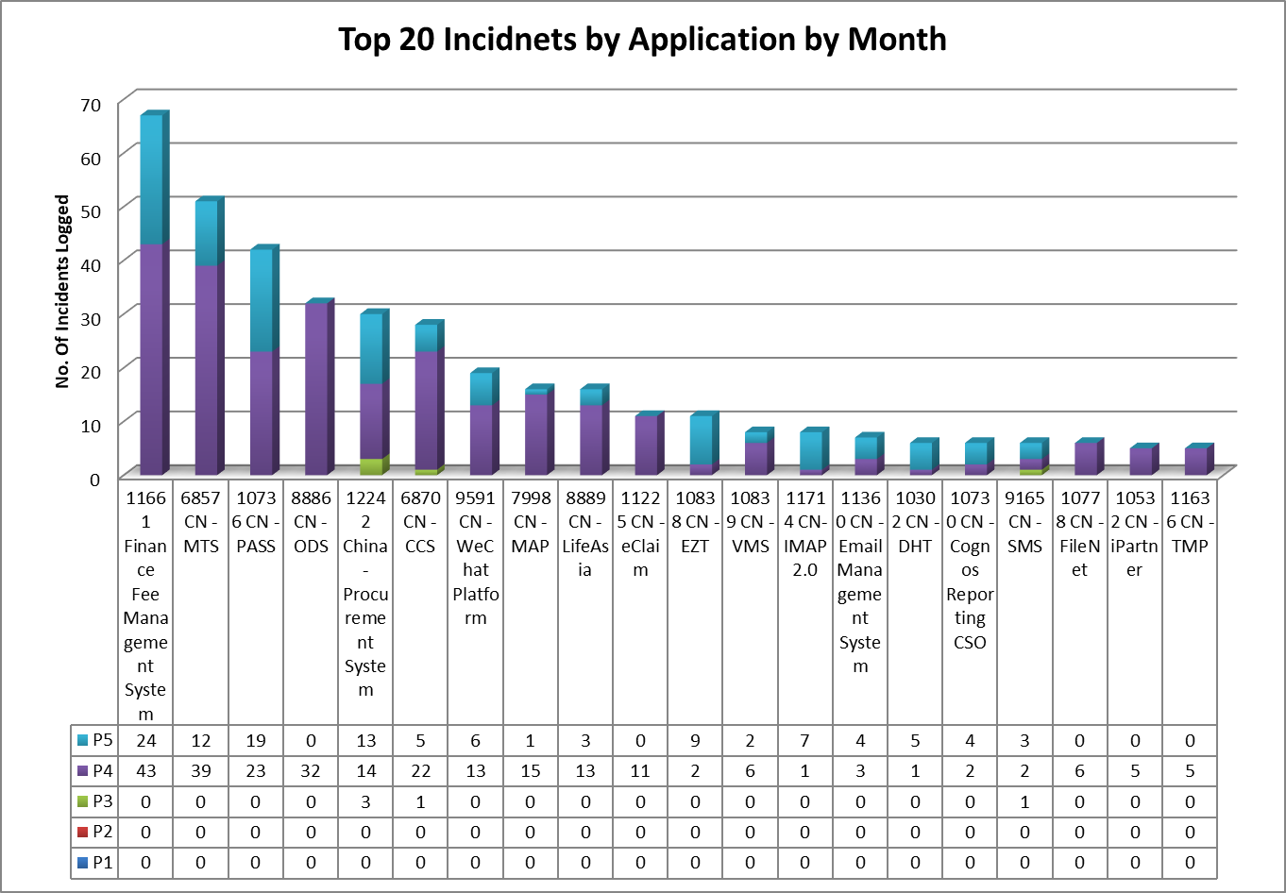
Incidents – Top Applications – AMS China
Comments
There is no P1, P2 incident in May.
2. Top 5 applications are FFMS, MTS, PASS, ODS and China Procurement System

Slide 7
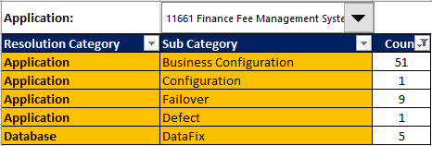
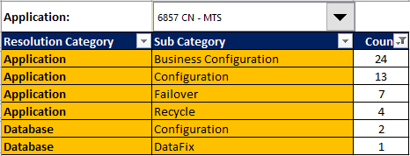

Incidents Summary By Category(Top 10)

Slide 8
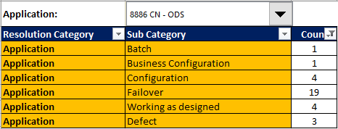
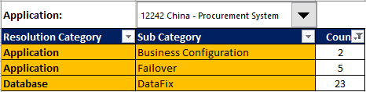
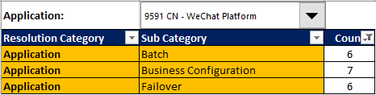
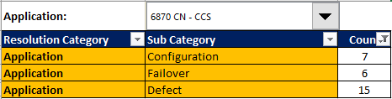
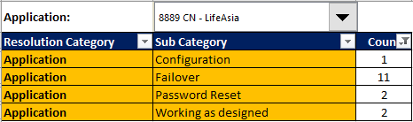
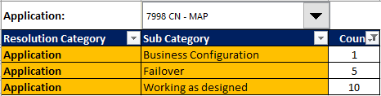
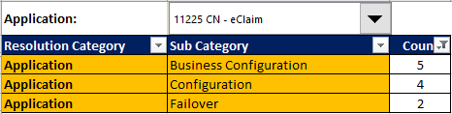
Incidents Summary By Category(Top 10)

Slide 9
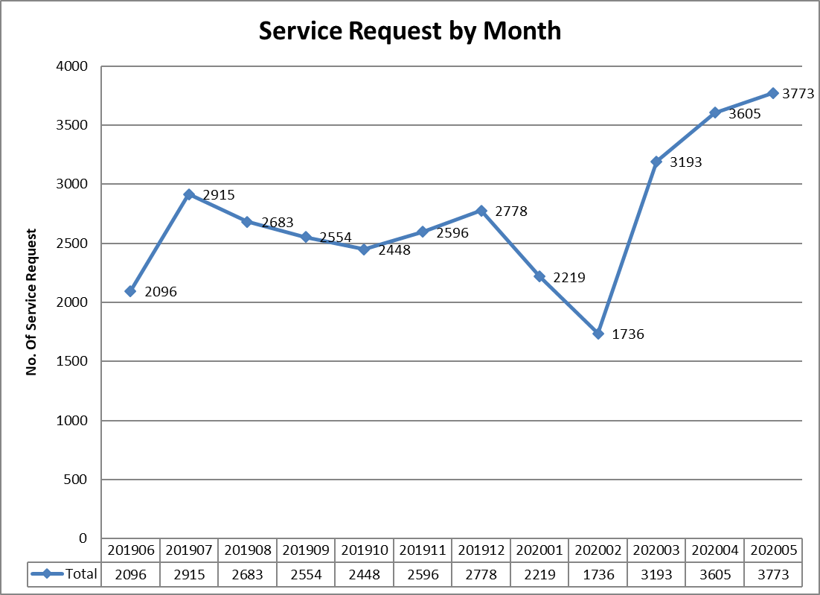
Service Requests – AMS China
Comments
Service Request tickets increased by 4.7% compare to number of month of Apr.

Slide 10
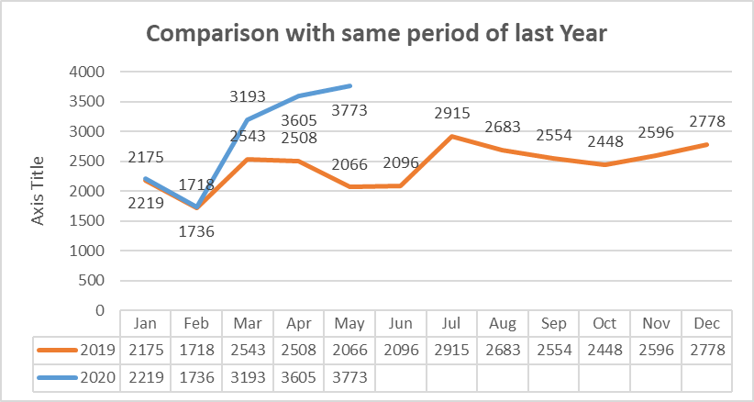
Service Requests – AMS China_Cont.
Comments
Service Request tickets is almost the same as the count of May 2019, which is increased by 82.6%.

Slide 11
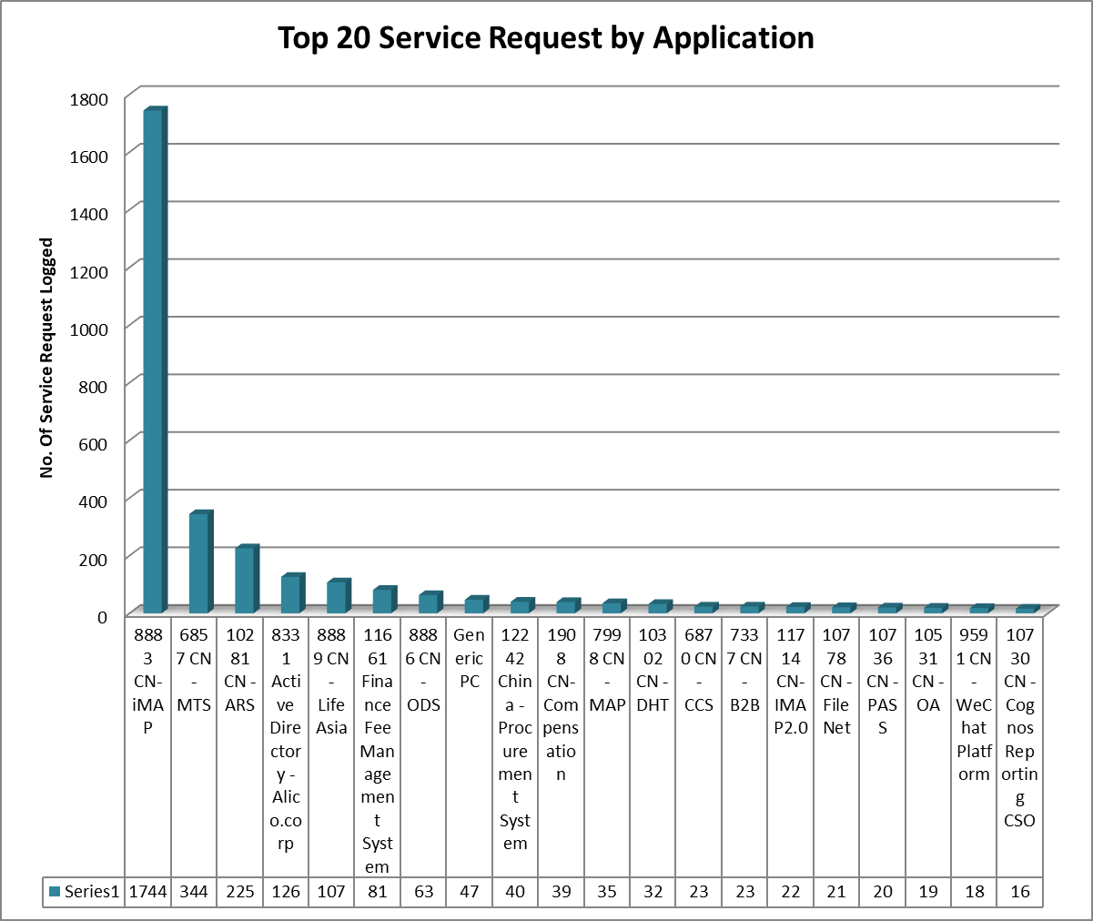
Service Requests – Top Applications – AMS China
Comments
iMap, MTS and ARS are top 3 applications of service request for current month.
99% tickets of iMap are for L1 Support
Top 3: 2313 61.3%
Top 20: 3045 80.7%
_____________________________
All: 3773

Slide 12
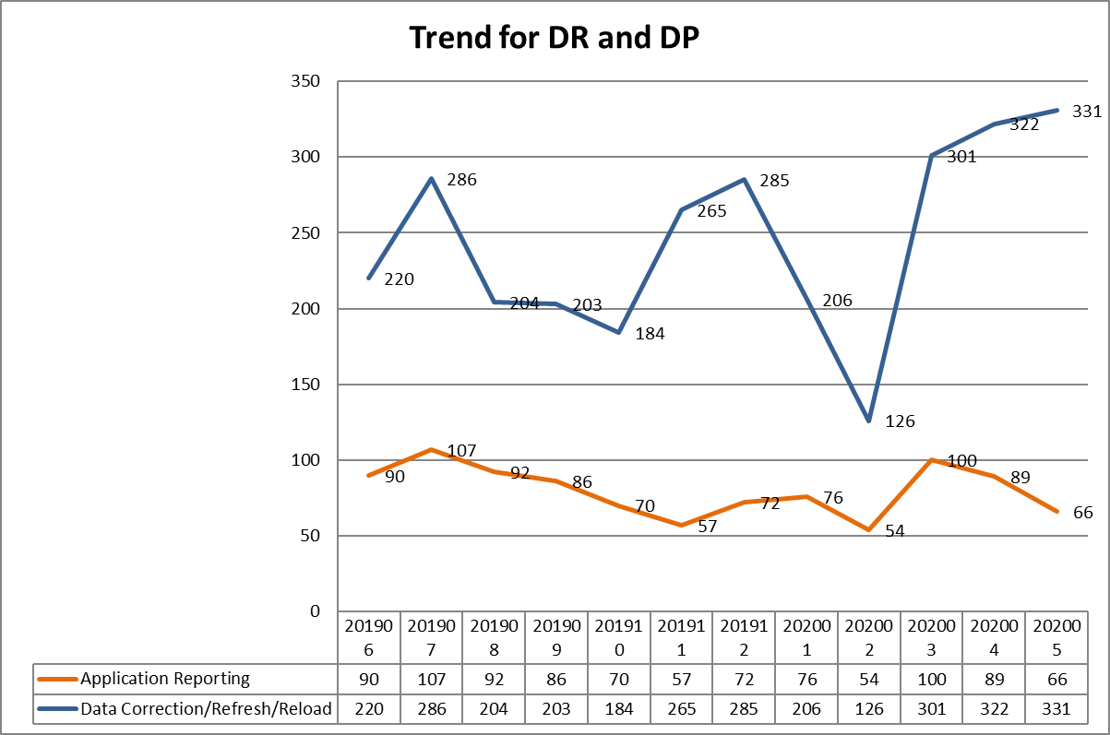
Trends for Data Request and Data Patch – AMS China
Comments
The total no. of DR tickets decreased by 25.8%, compare to number of month of Apr.
The total no. of DP tickets increased by 2.8%, compare to number of month of Apr.

Slide 13
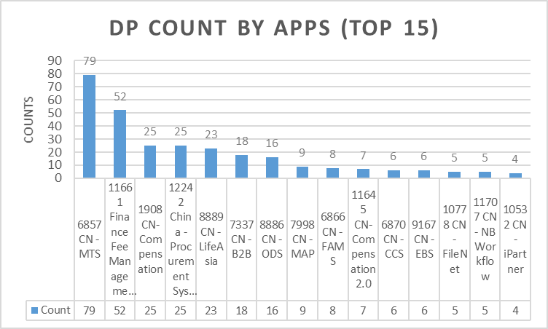
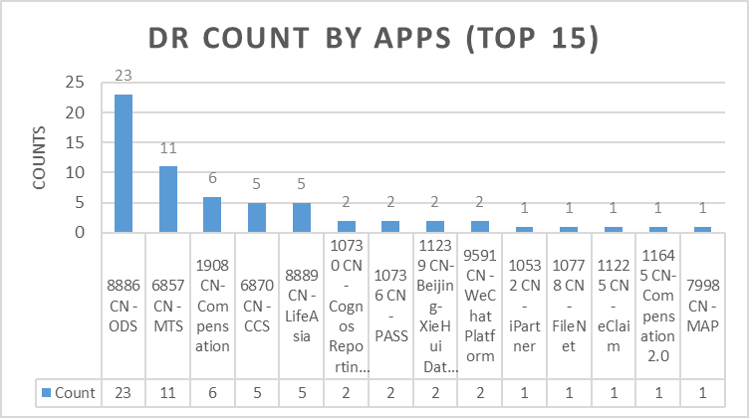
Data Request and Data Patch – AMS China
Comments
The top 3 applications for DP request are MTS, FFMS and Compensation.
The top 3 applications for DR request are ODS, MTS and Compensation.

Slide 14
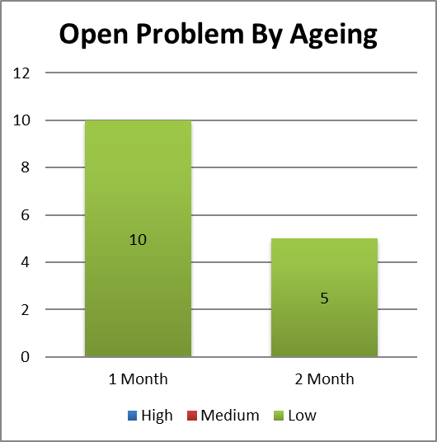
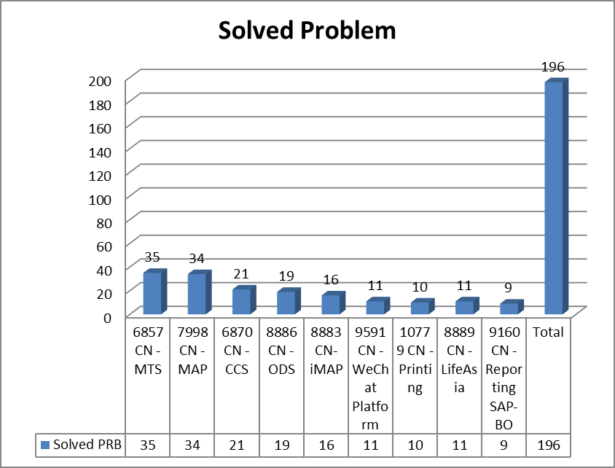
Problem Ticket –Ageing – AMS China
Comments
There is no High and Medium Open problem tickets until end of Jan
10 open problems aging are in 1 month and 5 open problems are over 2 month at the end of May, 2020.
4 of 15 open problems are either in UAT phase or waiting for PRD deployment.
In recent 12 months, there are 196 problems resolved. Top 3 application are MTS, Map and CCS.

Slide 15
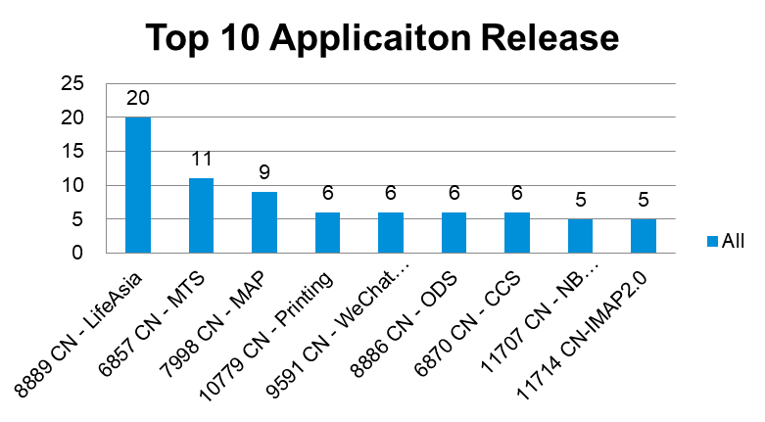
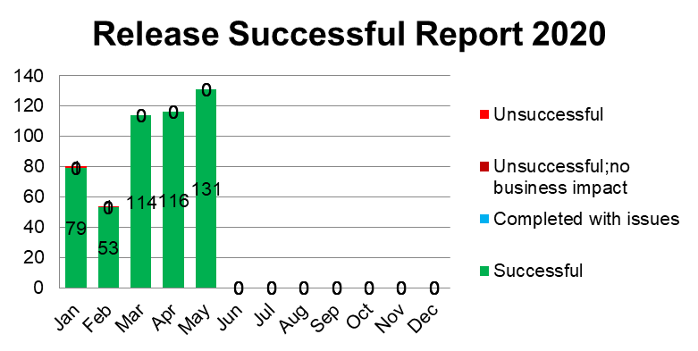
Release Management
Comments
There is no failure, rollback or incident happened in this month.
Release Result:
Successful - 131
Completed with issues - 0
Unsuccessful (no business impact) - 0
Unsuccessful - 0
Not Closed - 1

Slide 16
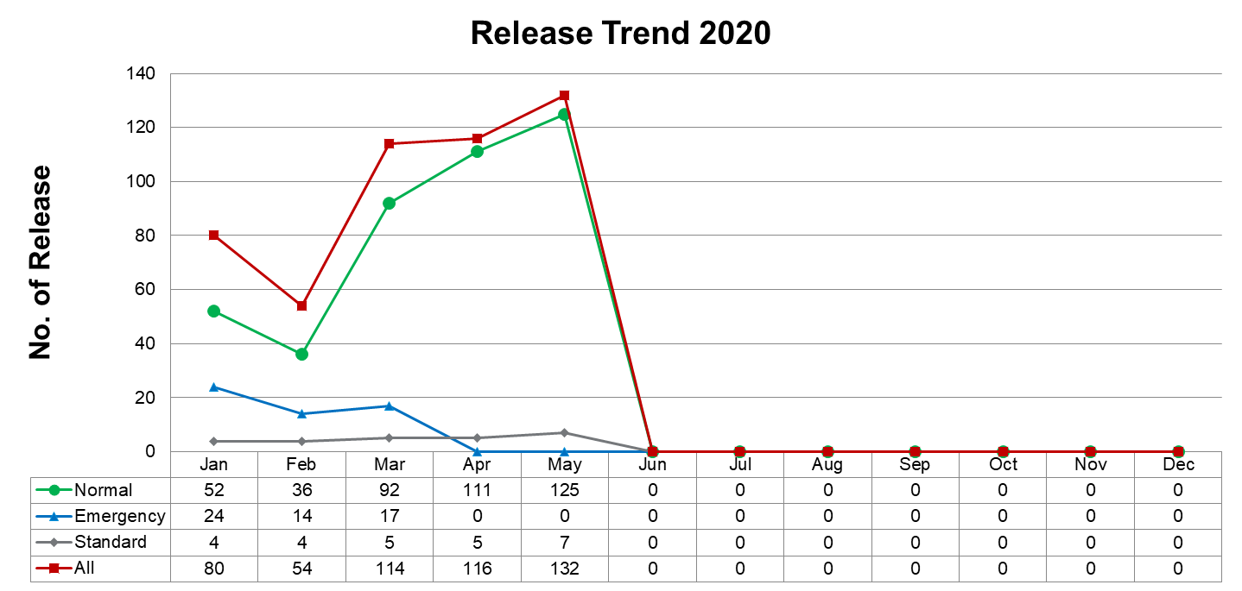
Release Management

Slide 17
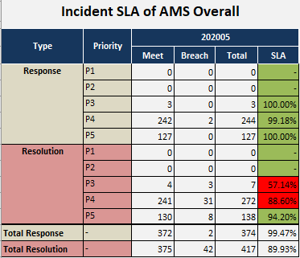
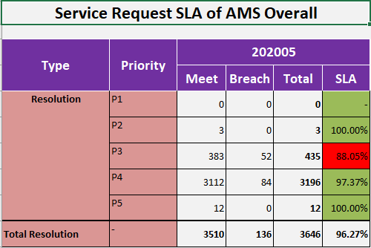
SLA – AMS China
Comments
Three P3 Incidents with SLA Breach are from Procurement System
24 out of 31 P4 Incident with SLA Breach are from Procurement System and Finance Fee Management System
41 out of 52 P4 Incident with SLA Breach are from Procurement System , Finance Fee Management System and Comp2.0 system

Slide 18
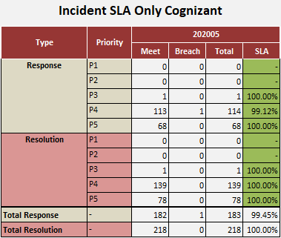
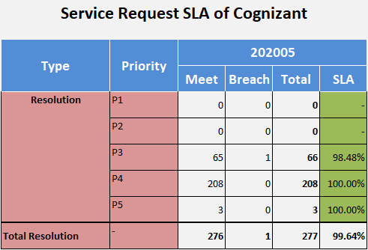
SLA – Cognizant
Comments
Incident SLA is all green for Cognizant.
Service Request SLA is all green for Cognizant.

Slide 19
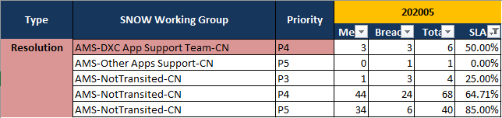
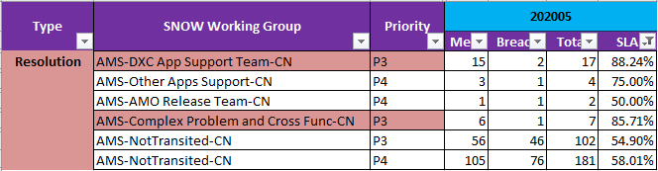
Incident SLA missed
SLA Miss Groups
SR SLA missed

